Slide 1

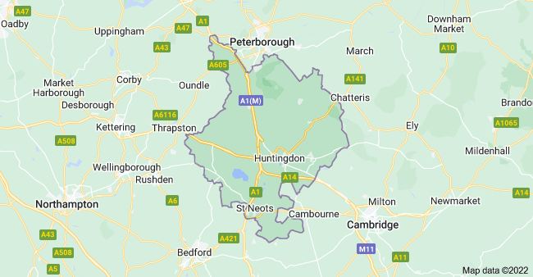
Welcome

Slide 2
Agenda comments
Welcome and introduction – Sophie Terrill
Huntingdonshire Policing Structure / Presentation, local update - Inspector Colin Norden
Crime Update – Inspector Colin Norden
Survey Results – Sophie Terrill, Think Communities Place Coordinator.
Public comments – please use chat to indicate you would like a 3-5 min slot to discuss an issue (you will be invited by the chair).
Summary and local action setting.
Huntingdonshire

Slide 3
Huntingdonshire Policing Structure
1 x Inspector
Huntingdon Team
1 Sergeant
7 Constables
3 PCSO
St Ives & Ramsey Team
1 Sergeant
2 Constables
2 PCSO
St Neots Team
1 Sergeant
4 Constables
1 PCSO
Five - 24/7 Reactive policing teams approximately 1 Inspector, 5 Sergeants and 30 Officers per team.
CID
Specialist team such as Traffic, Firearms, dogs unit, Rural community action teams,
Operational support (including drones).
Neighbourhood support team
Huntingdonshire

Slide 4
Crime Update – latest 3 months vs 3 months before.
Drugs
146 vs 92
Dwelling burglary
42 vs 55
Robbery
15 vs 11
Weapons
35 vs 20
All Racially Aggravated Crime
12 vs 19
Huntingdonshire

Slide 5
What are we focusing on?
What do we do and why?
Huntingdonshire

Slide 6
What are we focusing on?
Stop Search & ASB in Huntingdon Town Centre.
The neighbourhood team in Huntingdonshire conduct 25% of the forces stop searches.
We have a positive find rate of between 50-60% almost double the force average and well above the national average.
So why do we do it?
Data based on last 6 months.
Huntingdonshire

Slide 7
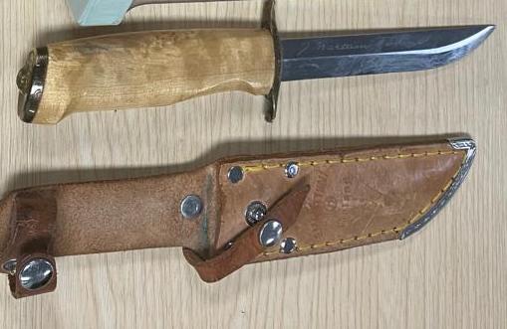
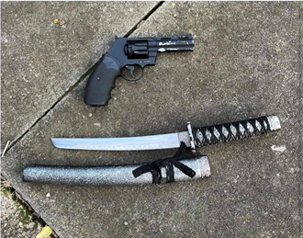
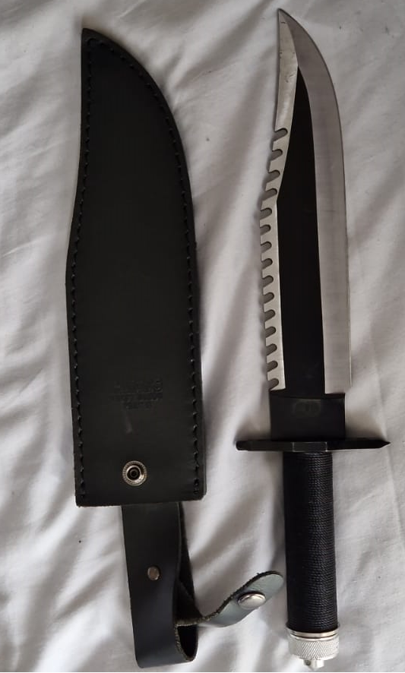
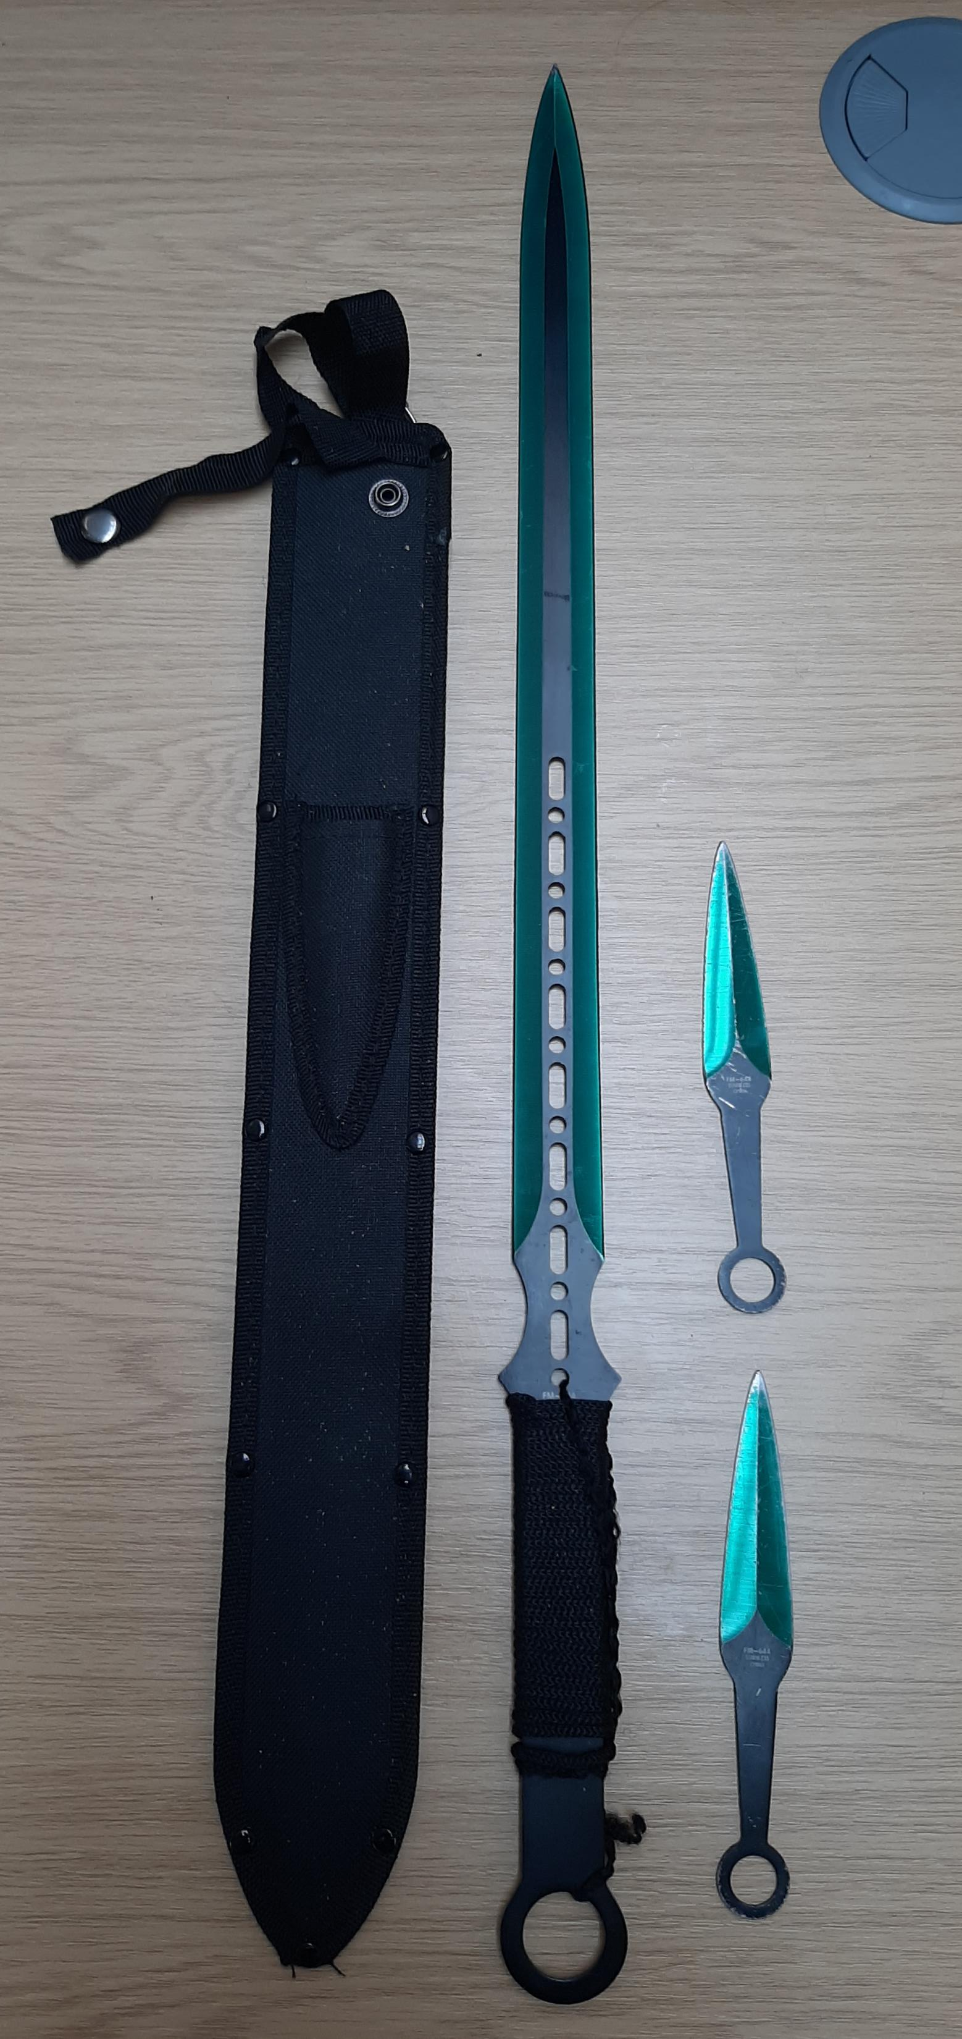
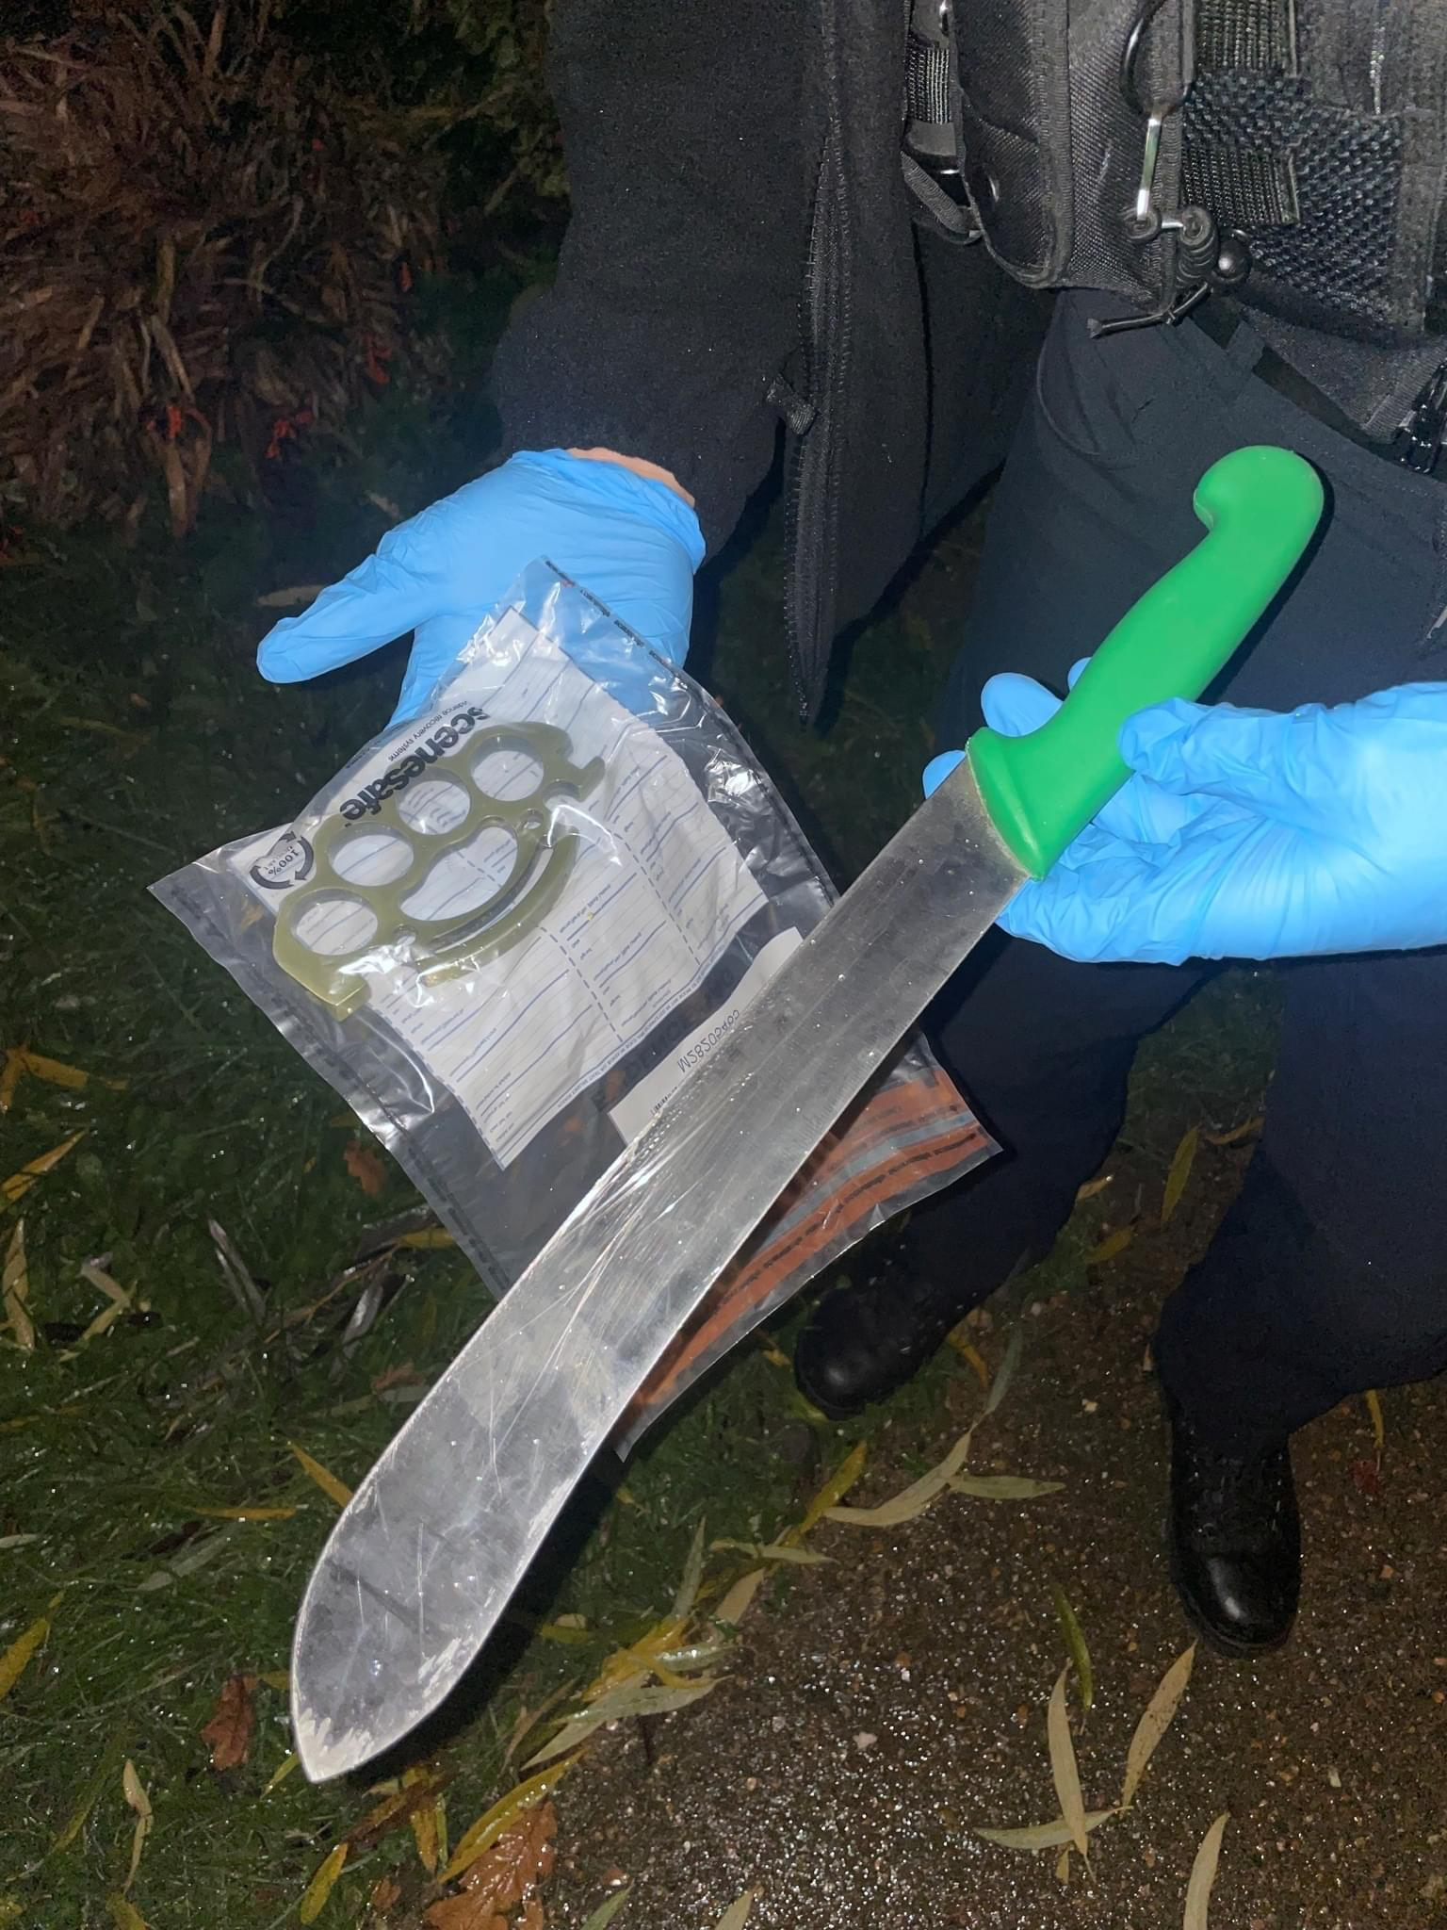
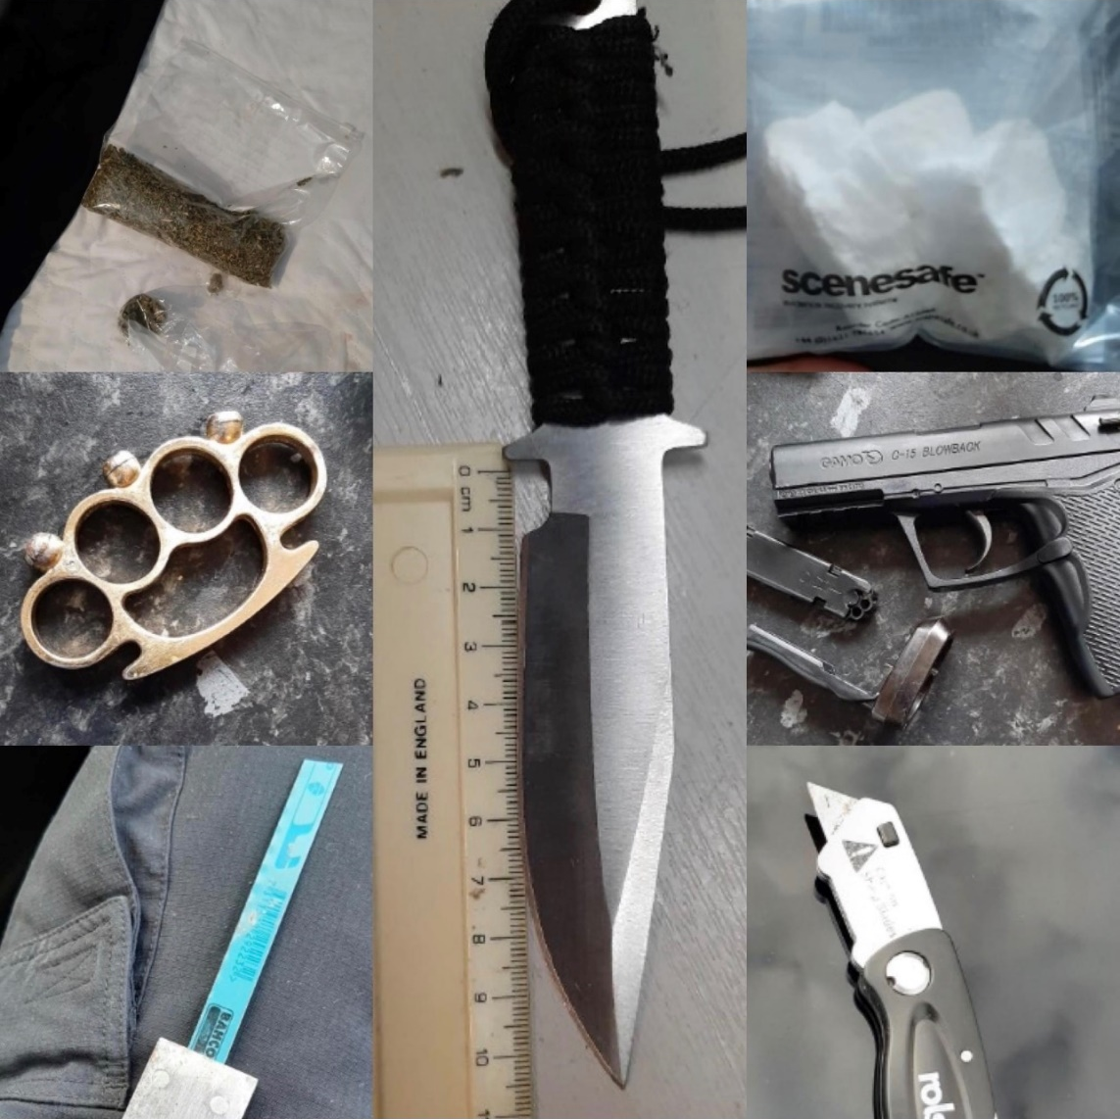
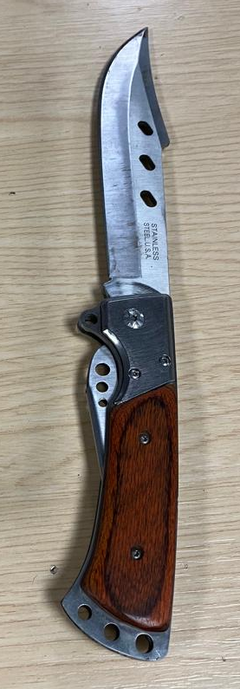
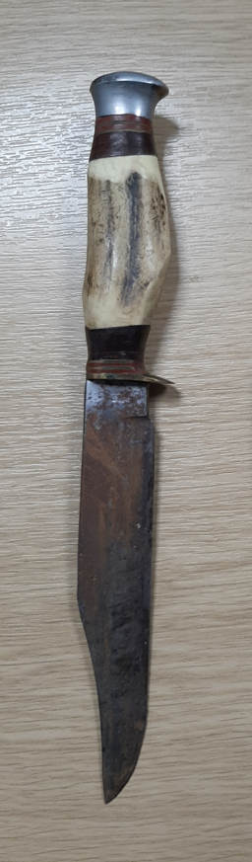

Slide 8
Survey introduction - Sophie Terrill
Tonight's meeting influences how your local team prioritise their “proactive” work.
Influence – tell us what matters to you.
Action – we can impact on important
issues you help us identify.
Answer – “you said we did” find out
how your local team took action or will.
Huntingdonshire

Slide 9
Survey
Once we have shared the survey results we will ask for comments.
Feel free to turn your camera on or leave it off.
We may ask to speak to you further off line, this may be to protect you, others or simply to find out a little more.
Tonight is about Huntingdonshire.
We will try and given everyone that wants to speak a chance to speak.
Huntingdonshire

Slide 10
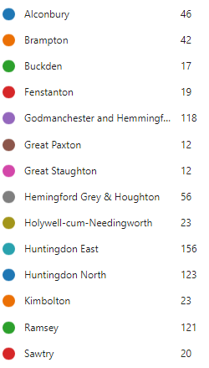
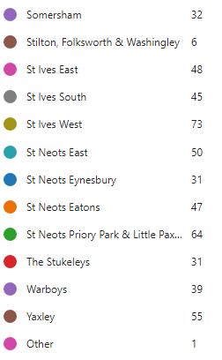
Survey results
Parking & traffic related concerns were raised in more that 50% of responses.
Huntingdonshire

Slide 11
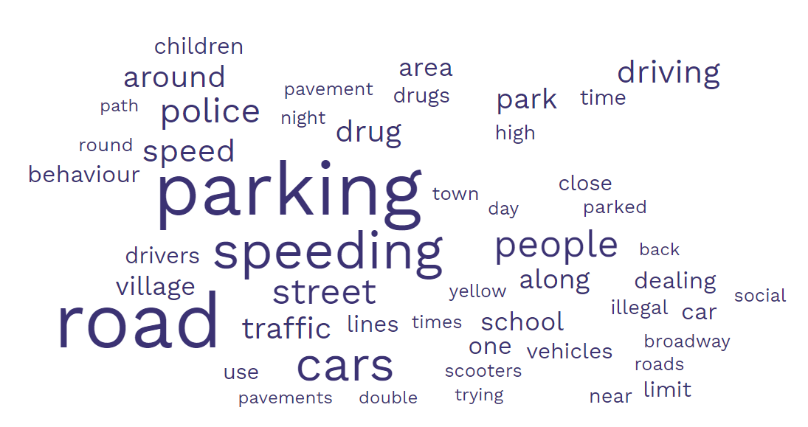
Survey results
Huntingdonshire

Slide 12
Survey results
The top 3 concerns reported were,
Parking – Ramsey & St Neots
Speeding – all areas
Drugs – all areas
We had 119 returns last month from under 16 year olds, their concerns,
Knife crime.
Youth gangs.
Sexual violence towards girls.
Huntingdonshire

Slide 13

Your view / Questions – (Non MBR ACRES)
Please wait to be invited to speak by the chair – thank you
Huntingdonshire

Slide 14
Next meeting..
Next meeting, 13th June 2023,
follow @HuntsCops or Policing Huntingdonshire for details.
Huntingdonshire

